Slide 1
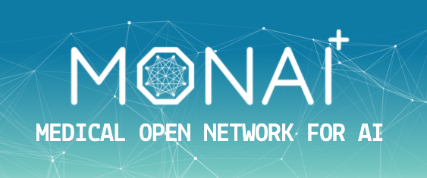
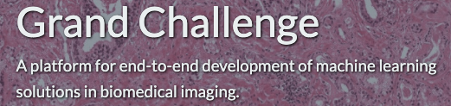


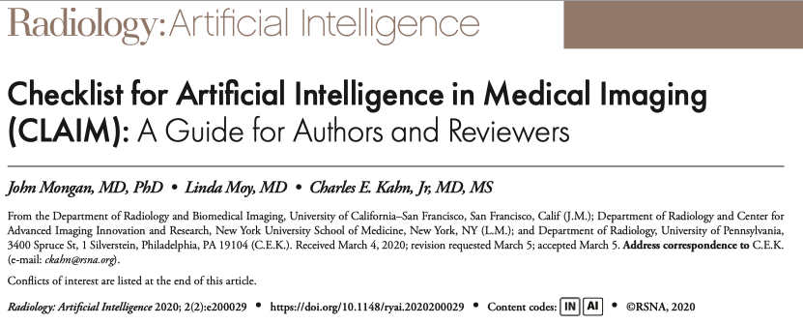
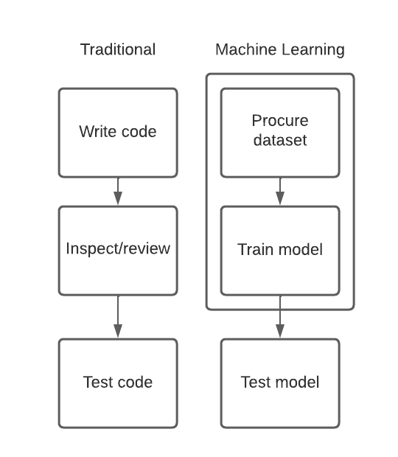
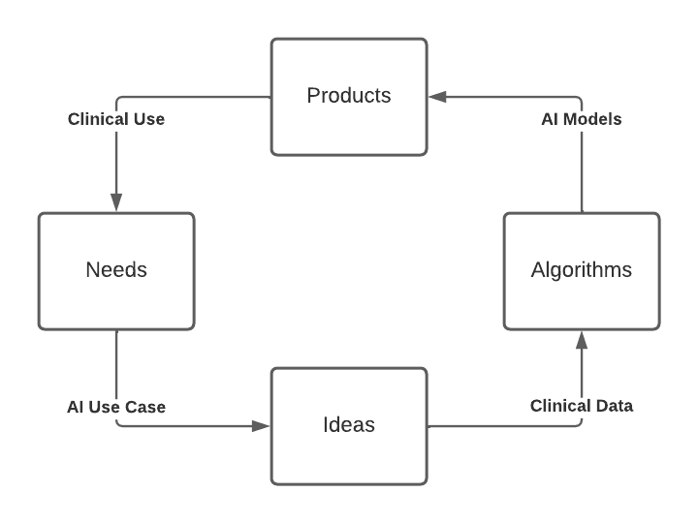
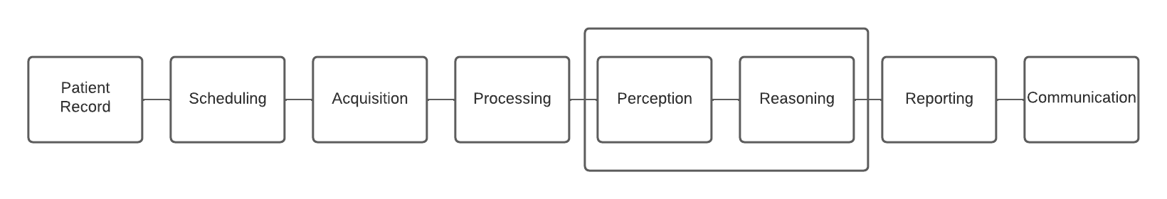
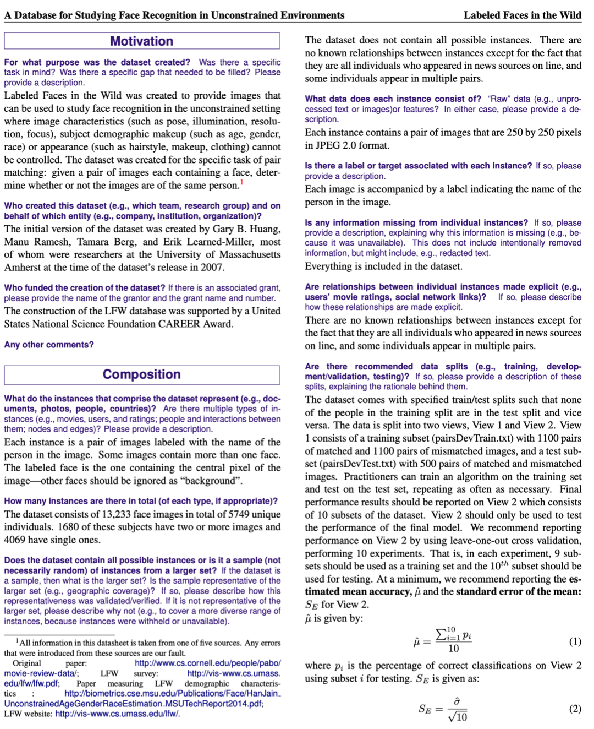
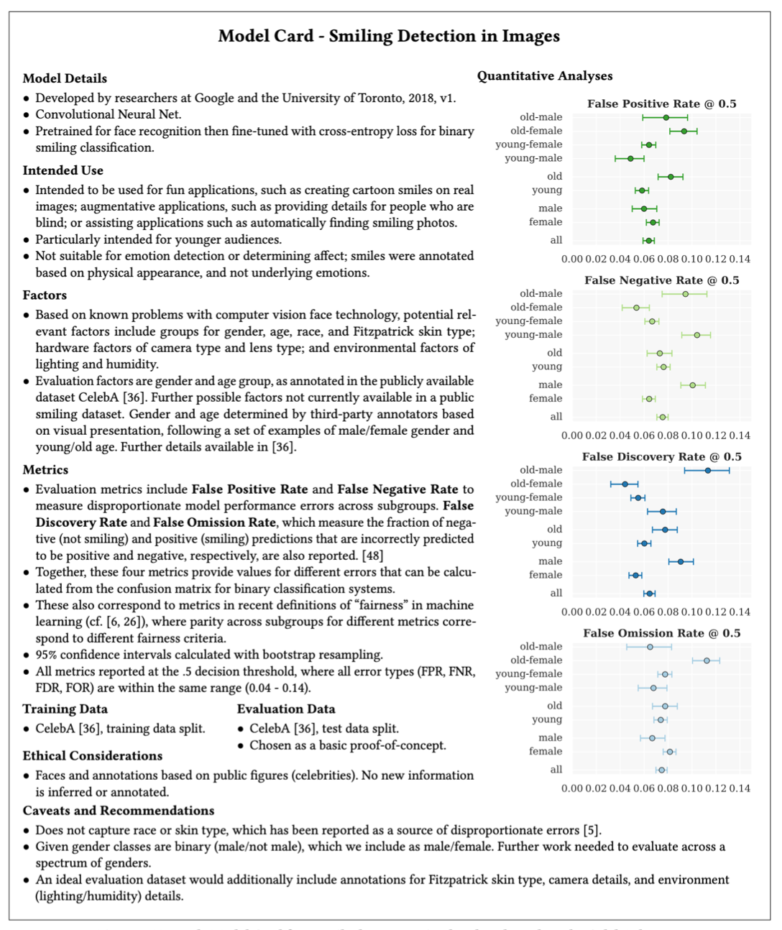
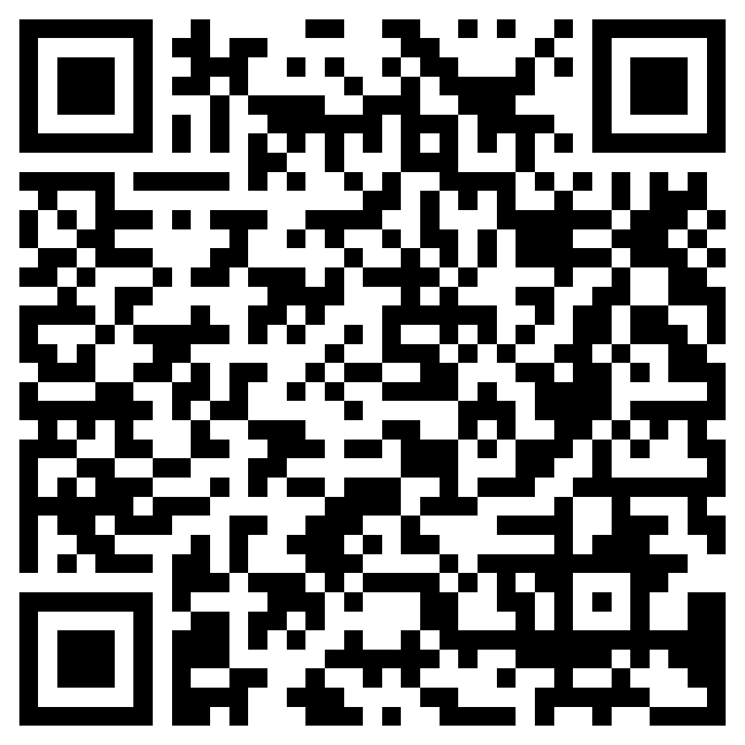
Deep Learning for Medical Image: A Recipe for Success
Oge Marques, Ph.D and Adam Corbin Florida Atlantic University, Boca Raton, FL.
BACKGROUND
TOOLS
COMPETITIONS
Problem: Medical imaging is a fast-paced discipline, and it can be difficult for a newcomer to navigate without assistance.
Hypothesis: A detailed checklist of factors to be considered while developing AI systems for medical applications could help someone maximize their success.
Contribution: When working in the field of medical imaging analysis, a collection of steps that organize what's essential.
PARTNERSHIPS
Medical Professional – Domain expert
Engineer, Computer Science, AI Software Developer
PUBLISH WORK
METHODS
DOCUMENT CODE
Identify opportunities
Search the literature
Select the best tools for the job
Build strong partnerships
Document code, data, and model
Enter challenges and competitions
Publish your work
Go beyond the code
Model Cards
Datasheets for datasets
Machine Learning
Define the problem
Procure a dataset
Train the model
Test the product
Release
Monitor
BEYOND THE CODE
OPPORTUNITIES
LITERATURE
Year | Number of publications | Number of references | Citations (until August 2020)
2017 | 7 | 1060 | 6089
2018 | 15 | 1684 | 947
2019 | 21 | 2279 | 408
Sum | 43 | 5023 | 7444
CONCLUSION
Partner with specialists now that you have the appropriate tools to create a lasting contribution in the field of medical image analysis.

